Slide 1

Web Foundations
PROG1247
Conestoga College

Slide 2

The CSS Box Model
Web Foundations
PROG1247
Prof. Andria Vanezi

Slide 3
We will be looking into…
What the CSS Box Model is, and
How we can use it for setting size for elements, adding space, borders, and backgrounds

Slide 4
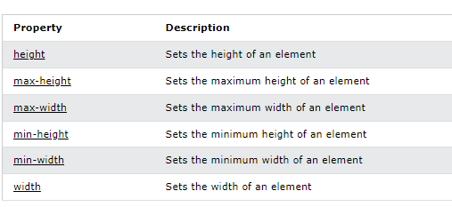
CSS Dimension Properties

Slide 5
CSS Setting height and width
The CSS height and width properties are used to set the height and width of an element.
The height and width properties do not include padding, borders, or margins.
It sets the height/width of the area inside the padding, border, and margin of the element.
The height and width properties may have the following values:
auto - This is default. The browser calculates the height and width
length - Defines the height/width in px, cm, etc.
% - Defines the height/width in percent of the containing block
initial - Sets the height/width to its default value
inherit - The height/width will be inherited from its parent value

Slide 6
Setting Height and Width Examples
Setting the width of the content area:
width: 450px; - Defines maximum width in px. Padding, margin and border are added to its total width
width: 75%; - Defines width as a percent (relative to the size) of the containing block. If it has any horizontal padding, margin or border, those will be added to its total width, making it occupy more (additional) horizontal space.
width: auto; - Default: element’s width is based on the width of its containing block. The element will occupy all available horizontal space within its containing block. If it has any horizontal padding, margin or border, those will not be added to its total width – ie. the width of the content area will shrink accordingly, and it will still occupy the same amount of horizontal space.
Setting the height of the content area:
height: 125px; - Defines maximum height in px. Padding, margin and border are added to its total height.
height: 50%; - Defines height as a percent (relative to the size) of the containing block.
height: auto; - Default: element’s height is based on the height of its content

Slide 7
Setting max-width
The CSS max-width property is used to set the maximum width of an element.
The max-width can be specified in length values, like px, cm, etc., or in percent (%) of the containing block, or set to none (this is default. Means that there is no maximum width).
Note: If you both the width property and the max-width property on the same element, and the value of the width property is larger than the max-width property; the max-width property will be used (and the width property will be ignored).

Slide 8
Defining Size
Units are used to define length or size values and they can be associated with properties like font-size, width, border-width, padding, and so many more.
Relative units
define different sizes such as the width of an element, font size, border width etc. relative to something else on the page.
em – relate to current font-size
rem—relative to root element font size
% relative to parent element
The following video explains relative units in CSS: https://www.youtube.com/watch?v=tSoHeAtGMk8
Viewport units
A viewport is a visible area on a computer screen and the viewport units are defined relative to the width and height of the viewport.
vw- relative to viewport width
Vh – relative to viewport height
The following video explains the viewport units: https://www.youtube.com/watch?v=wQxjm7sgZ3Y
Absolute units
absolute in nature and are defined using the pixels on the screen.
px, cm, mm, in, pt, pc
The following video explains absolute units in CSS: https://www.youtube.com/watch?v=_YnVRj2z-YM
Accessibility Tip: The page should be readable and functional when the page is zoomed to 200%
Responsive Deign: use rem units to ensure measurements remain proportional

Slide 9
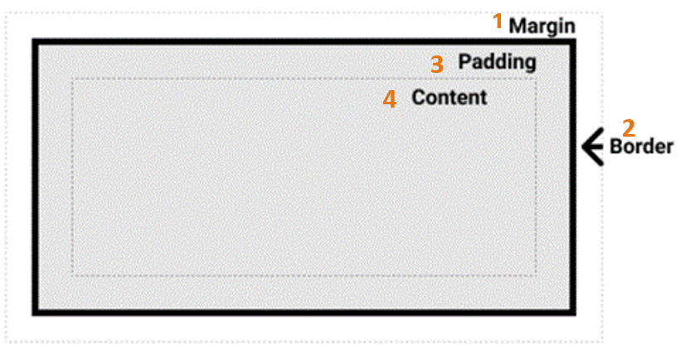
Box Model
The CSS box model elements:
Margin box
Border box
Padding box
Content box
Figure 1. The CSS box model.
Note. From Mozilla Contributors, 2019. CC BY-SA 2.5

Slide 10
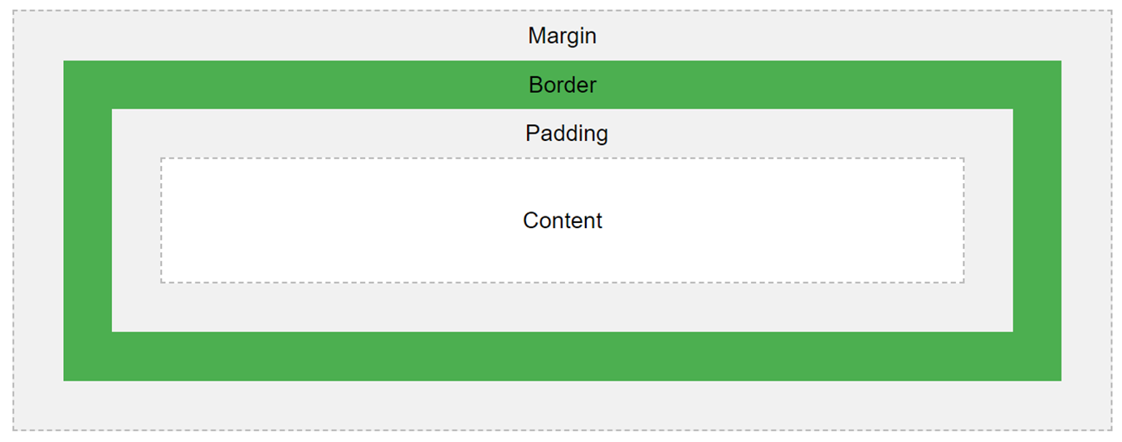
The CSS Box Model
HTML web pages are built up of boxes.
One box is created for each HTML element by the browser when it renders the HTML.
By understanding the CSS Box Model we can build more complex layouts = more attractive designs.
Everything in CSS has a box around it, and understanding these boxes is key to being able to create layouts with CSS, or to align items with other items.
The CSS Box Model allows us to add a border around elements, and to define space around and between elements.
The box consists of:
the content area – the content of the box (text, images) goes here
padding – space around the content, inside the border
border – the border that goes around the padding and content
margin – space outside the border
Sources: https://www.w3schools.com/css/css_boxmodel.asp, https://developer.mozilla.org/en-US/docs/Learn/CSS/Building_blocks/The_box_model

Slide 11
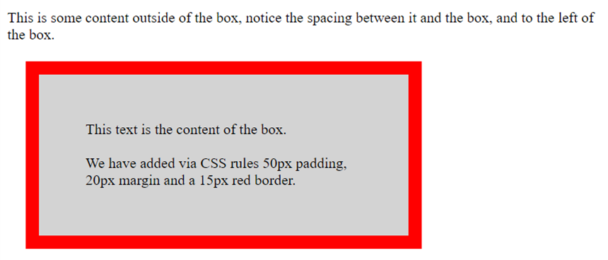
Demonstration of the Box Model
<!DOCTYPE html>
<html>
<head>
<style>
div {
background-color: lightgrey;
width: 300px;
border: 15px solid red;
padding: 50px;
margin: 20px;
}
</style>
</head>
<body>
<p>This is some content outside of the box, notice the spacing between it and the box, and to the left of the box.</p> <div>
This text is the content of the box.
<br><br>
We have added via CSS rules 50px padding, 20px margin and a 15px red border.
</div>
<body>
</html>
Source: https://www.w3schools.com/css/css_boxmodel.asp

Slide 12
Setting Height and Width of an Element
To set the width and height of an element correctly, we need to know how the box model works.
When setting the width and height properties of an element with CSS, we only set the width and height of the content area.
To calculate the full size of an element, together with its box, we must also add padding, borders and margins.
The formula for calculating the total width of an element:
total element width = width + left padding + right padding + left border + right border + left margin + right margin
The formula for calculating the total height of an element:
total element height = height + top padding + bottom padding + top border + bottom border + top margin + bottom margin

Slide 13
Example: Calculating Full Width of an Element
div {
width: 300px;
padding: 50px;
border: 15px solid red;
margin: 20px;
}
Width calculation:
300px (width) + 100px (left + right padding) + 30px (left + right border) + 40px (left + right margin) = 470px

Slide 14
Adding space between elements with margins
The CSS margin properties are used to create space around elements, outside of any defined element borders.
There is a CSS property for setting margin for each individual side of an element - top, right, bottom, and left:
margin-top
margin-right
margin-bottom
margin-left
It is also possible to specify margins for all 4 sides using the margin property, which is the shorthand property here.
Margins can be expressed using any of the following values/units:
px, pt, cm, em, rem
% - specifies a margin as a % of the width of the containing element
inherit - specifies that the margin should be inherited from the parent element

Slide 15
Setting margins, examples
Setting margin for individual sides of an element:
margin-top: .5em;
margin-right: 1em;
margin-bottom: 2em;
margin-left: 1em;
Setting margins for multiple sides of an element, using the shorthand margin property:
margin: 1em; - 1 value: 1em for each of the four sides
margin: 2em 1em; - 2 values: top and bottom 2em, right and left 1em
margin: .5em 1em 2em; - 3 values: top .5em, right and left 1em, bottom 2em
margin: .5em 1em 2em 1em; - 4 values: top .5em, right 1em, bottom 2em, left 1em

Slide 16
More on margins: margin collapsing
If we specify a bottom margin for one element and a top margin for the element that follows, the margins are collapsed – meaning that the smaller margin is ignored and only the larger margin is applied.
Ex: The actual margin between <h1> and <h2> elements below will be 35px (vs. 10 + 35 = 45 px)
h1 { margin: 0 0 10px 0;
}
h2 { margin: 35px 0 0 0;
}
...
<body> <h1>Main Heading</h1>
<h2>A subheading</h2>
</body>
…

Slide 17
More on margins: good practices & tips
Different browsers have different default margins for block elements.
A good practice is to set margin for all elements to 0, at the top of the stylesheet, and then explicitly define margins for the elements you are using and the way you want them to be. This gives you more control over the spacing between the elements and makes sure the elements’ margins will be the same in all browsers.
* {
margin: 0;
padding: 0;
}
To horizontally center a page in browser window, or a block element within its containing (parent) block:
set both left and right margin for the element to be centered to auto, and
define width for the element.
Ex: to center <main> element inside its container element main {
margin: 10px auto;
width: 400px;
}

Slide 18
Align Center
Center Align Element
To horizontally center a block element, use margin: auto;
Setting the width of the element will prevent it from stretching out to the edges of its container.
The element will then take up the specified width, and the remaining space will be split equally between the two margins
Note: Center aligning has no effect if the width property is not set (or set to 100%).
Center Align Text
To just center the text inside an element, use text-align: center;
Center an Image
To center an image, set left and right margin to auto and make it into a block element

Slide 19
Adding space around an element’s content - with padding
The CSS padding properties are used to create space around an element's content, inside any defined borders.
There is a CSS property for setting padding for each individual side of an element - top, right, bottom, and left:
padding-top
padding-right
padding-bottom
padding-left
It is also possible to specify padding for all 4 sides using the padding property, which is the shorthand property here.
Padding can be expressed using any of the following values/units:
Expressed in px, pt, cm, em, rem, etc.
% - specifies a padding as a % of the width of the containing element
inherit - specifies that the padding should be inherited from the parent element

Slide 20
Setting padding, examples
Setting padding for individual sides of an element:
padding-top: 0;
padding-right: 1em;
padding-bottom: .5em;
padding-left: 1em;
Setting padding for multiple sides of an element, using the shorthand padding property:
padding: 1em; - 1 value: 1em for each of the four sides
padding: 0 1em; - 2 values: top and bottom 0, right and left 1em
padding: 0 1em .5em; - 3 values: top 0, right and left 1em, bottom .5em
padding: 0 1em .5em 1em; - 4 values: top 0, right 1em, bottom .5em, left 1em

Slide 21
Setting borders around an element
The CSS border properties allow us to specify style, width, and color of an element's border.
CSS properties for setting borders:
border-style
border-width
border-color
border-radius

Slide 22
CSS border-style property
The border-style property specifies what kind of border to display.
The other CSS border properties will not have effect unless the border-style property is set.
The following are some of the possible values for this property: solid, dotted, dashed, double, inset, outset, none (indicates that there should be no border)
The border-style property can have from one to four values. Ex:
p { border-style: dashed; } - 1 value: all four sides will have dashed border
p {border-style: dotted solid; } - 2 values: top and bottom dotted, left and right solid border
p { border-style: dotted solid double; } - 3 values: top dotted, right and left solid, bottom double border
p { border-style: dashed solid dashed solid; } - 4 values: top and bottom dashed, right and left solid border
There are also additional CSS properties for specifying border style for each of the individual sides. Ex:
p { border-bottom-style: dashed; } - style (dashed) specified for bottom border only
p { border-left-style: solid; } - style (solid) specified for left border only

Slide 23
CSS border-width property
The border-width property specifies the width of the borders around an element.
The width can be set using px, pt, cm, em, rem. (use rem or em) Ex: border-width: 5px;
The border-width property can have from one to four values. Ex:
p { border-width: 5px; } - 1 value: all four sides will have 5px wide border
p { border-width: 5px 4px;} - 2 values: top and bottom 5px, left and right 4px
p { border-width: 5px 4px 2px; } - 3 values: top 5px, right and left 4px, bottom 2px
p { border-width: 5px 4px 2px 3px; } - 4 values: top 5px, right 4px, bottom 2px, left 3px
There are also additional CSS properties for specifying border width for each of the individual sides. Ex:
p { border-bottom-width: 2px; } - 2px width specified for bottom border only
p { border-left-width: 4px; } - 4px width specified for left border only

Slide 24
CSS border-color property
The border-color property is used to set the color of an element’s borders border-color: red; border-color: #ff0000 - red colour, set using an RGB value
The border-color property can have from one to four values.
p { border-color: red; } - 1 value: all four sides will have a red border
p { border-color: red blue;} - 2 values: top and bottom red, left and right blue
p { border-color: red blue green; } - 3 values: top red, right and left blue, bottom green
p { border-color: red blue green red; } - 4 values: top red, right blue, bottom green, left red
There are also additional CSS properties for specifying border width for each of the individual sides.
p { border-bottom-color: red; } - red color specified for bottom border only
p { border-left-color: green; } - green color specified for left border only

Slide 25
CSS border Property
There is also a shorthand border property, that lets us set the first three of the above border properties all together.
It is possible to specify all three individual border properties in one, border, property.
Using border as a shorthand property helps us shorten the code.
The border property is used to specify together border-width, border-style and border-color property – in that order.
Ex:
div { border: 2px solid red; - 2px wide, style: solid, color: red – applied to all four sides }
There are also additional properties for specifying all the individual border properties for just one side.
Ex:
border-bottom: 2px solid red; - border properties specified for the bottom border only
border-right: 1px dotted blue; - border properties specified for the right border only
border-left: none; - indicates that there is no border on the left side

Slide 26
CSS border-radius Property
border-radius property is used to add rounded borders to an element.
div { border: 3px solid blue; border-radius: 11px; - all four corners will have 11px radius }
The border-radius property can use a combination of different values, for the 4 different corners
p {
border: 3px solid blue; - top-left 11px, top-right 5px, lower-right 0, lower-left 7px corner;
border-radius: 11px 5px 0 7px;
}

Slide 27
CSS box-shadow Property
box-shadow property applies shadow to elements.
Syntax:
box-shadow: horizontalShadow verticalShadow blurEffect spread color;
Can specify all or some of the values:
only the horizontal shadow and the vertical shadow: box-shadow: 10px 10px;
the horizontal shadow and the vertical shadow, and with the shadow colour: box-shadow: 10px 10px grey;
the horizontal shadow and the vertical shadow, shadow colour, and with the blur effect: box-shadow: 10px 10px 8px grey;
the horizontal shadow and the vertical shadow, shadow colour, blur effect and spread: box-shadow: 10px 10px 8px 4px grey;

Slide 28
References
https://www.w3schools.com/css/css_boxmodel.asp
https://www.w3schools.com/css/css_dimension.asp
https://www.w3schools.com/css/css_padding.asp
https://www.w3schools.com/css/css_margin.asp
https://www.w3schools.com/css/css_border.asp

